Slide 1
THE PHYLOGENY OF PYTHIUM AND PHYTOPHTORA GENERA
Sarah Caroline de Souza
PP563 - Phylogenetic Analysis of Molecular Data

Slide 2
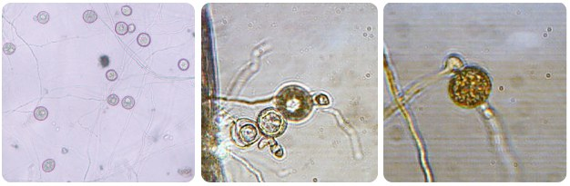
INTRODUCTION
Phytophthora species (P. sojae and P. sansomeana) and several Pythium and Phytopythium species are the primary sources of root and stem rot in soybeans.
Oomycete ( = water mold) ⇨ absolutely need water.
Notes:
Water is needed because these pathogens can only have oospores germinated when in the presence of flooded soils and high temperatures. When these conditions are not found these microorganisms can still survive for years.
Even though P. sojae can be extremely pathogenic. The genus Pythium is the most abundant and diverse. Showing an amazing amount of species present in the soil. These species are ubiquitous and not necessarily pathogenic, although some of them can cause extremely severe damages not only to soybeans but to a great variety of hosts.
In soybeans, these pathogens are extremely bad and are considered the second most destructive disease, causing around 2 billions of losses for soybean growers in the United States.

Slide 3

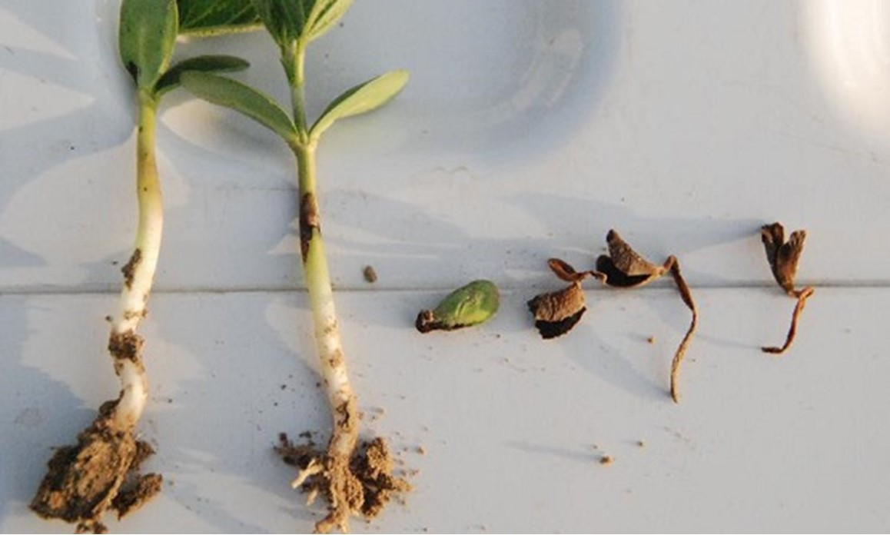
SYMPTOMS
The high similarity of symptoms caused by the different pathogens makes the identification in field impossible.

Slide 4

WHY TO BUILD A PHYLOGENETIC TREE?
The tree of these species can help us understand the evolutionary aspects and how it molded the behavior of these pathogens.

Slide 5
01
ASSEMBLING AND ALIGNING
Notes:
The assembling (preparation of the sequence reads) were done using the Geneious Prime software (paid version). The alignment was also performed using this software since I had technical issues installing the MSA programs.

Slide 6
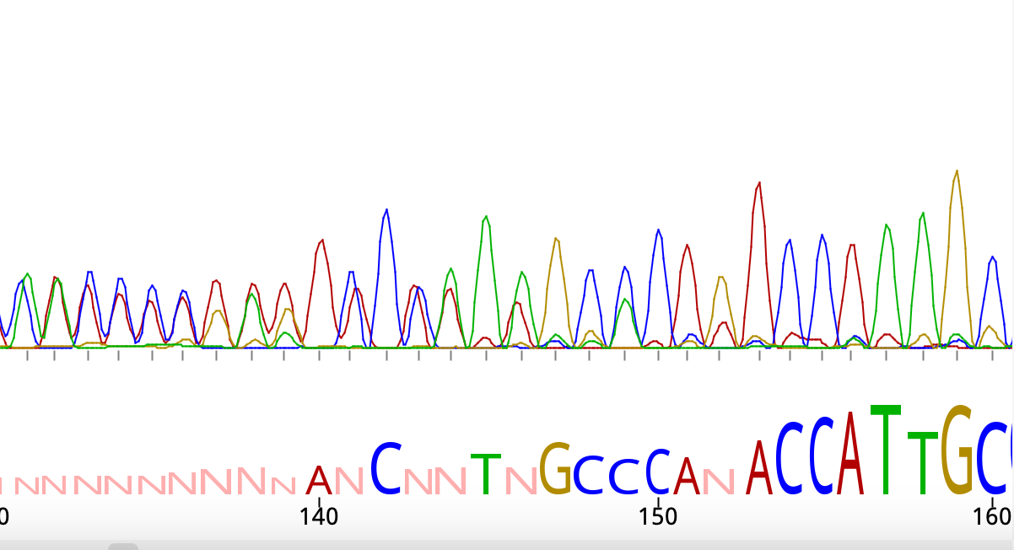
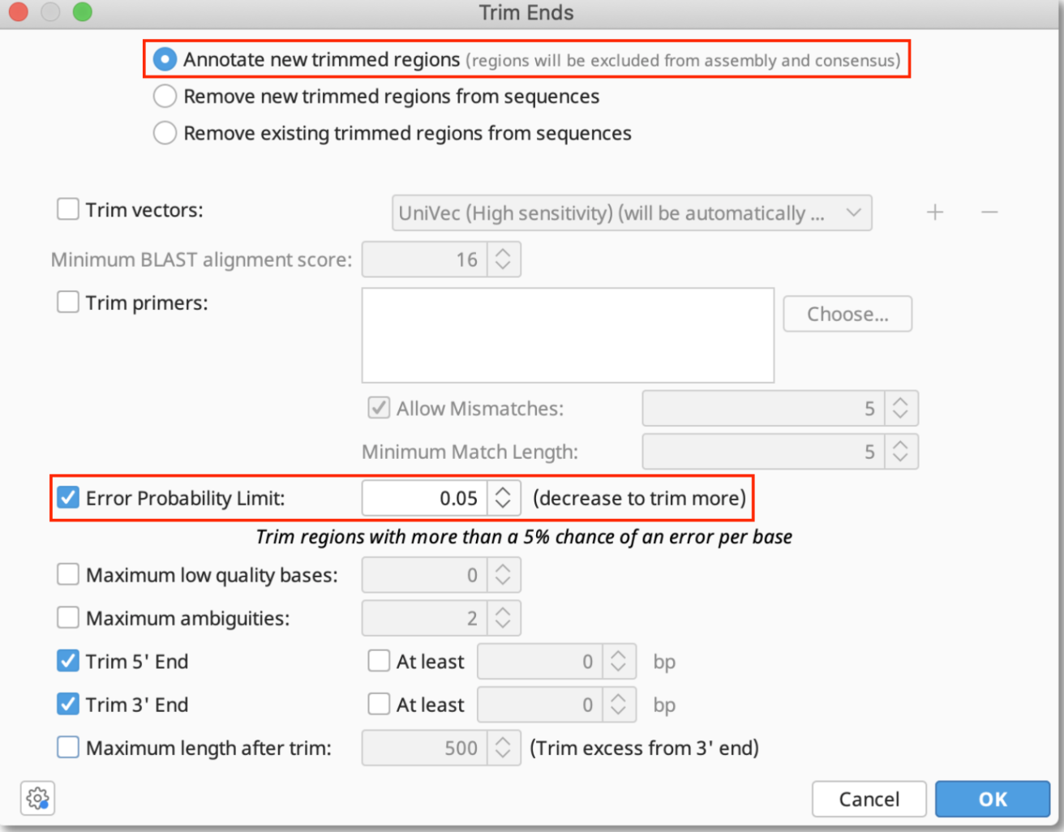
PREPARING THE SEQUENCES
Trimming poor quality edges from the SANGER sequences (ab1 format) (ITS 6 – forward and 4 - reverse) (Modified-Mott algorithm).
ITS 6 (forward) and ITS 4 (reverse) were assembled into one consensus sequence (De Novo assemble -Tadpole algorithm)
Notes:
Modified Mott: This algorithm is based on quality and operates by subtracting the base error probability from an error probability cutoﬀ value (default 0.05) to form the base score.
Tad-pole: This assembler considers each contig as unique kmers - subsequences of length K from the sequence - in a way that the contigs will not overlap by more than K-1 bases.
Although we sequenced 480 samples we were only able to successfully assemble 106 due to poor quality or short reads.

Slide 7
ALIGNING THE SEQUENCES
106 sequences
MUSCLE
Alignment
Sequences length varied from 417 to 1,011 bp.
MUltiple Sequence Comparison by Log-Expectation
The total length after the alignment was 1,399 bp.

Slide 8
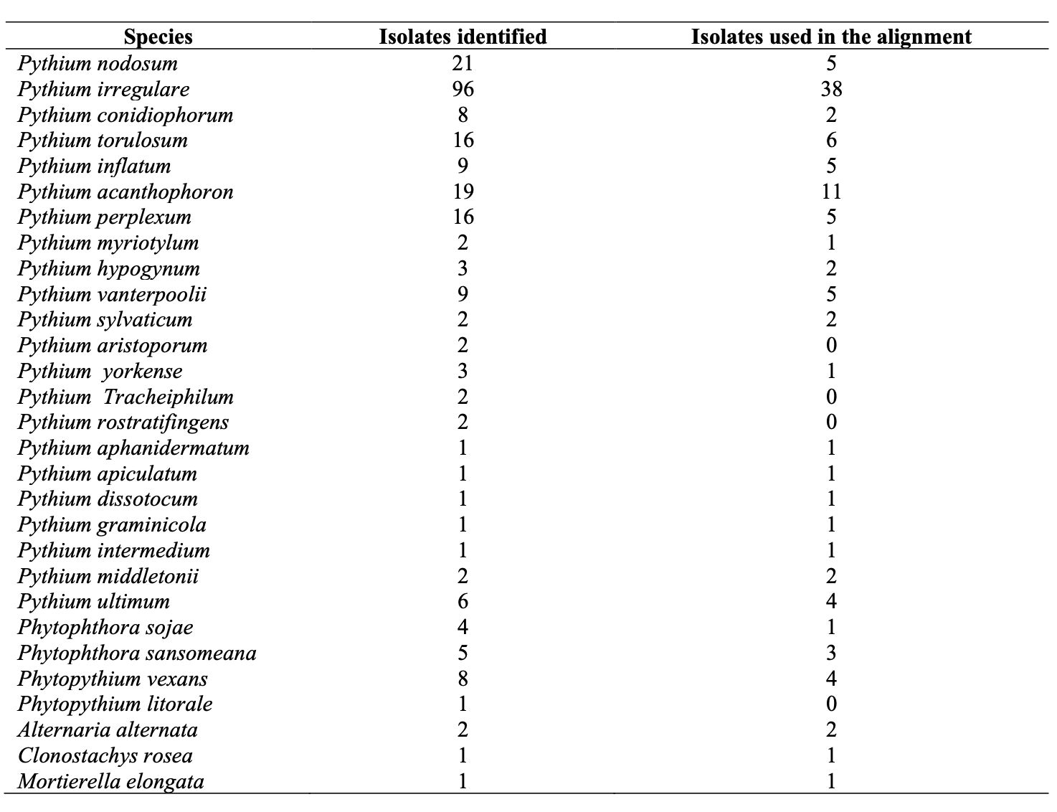
Species identified
Notes:
SEQUENCES WERE IDENTIFIED USING BLAST.
Although we were able to retrieve and identify some of the species, if we didn’t assemble them in a consensus file between the reverse and forward we didn’t use these reads to align.
We retrieved a few fungal species that we decided to keep in alignment even though they are not oomycete species, for reference purposes only. However, only the fungal species Mortierella elongata was used as my outgroup for rooting my trees. The selection of this fungal species was primarily because it serves as a suitable outgroup due to its phylogenetic position when compared to the Pythium and Phytophthora genera.

Slide 9
02
BUILDING THE TREES

Slide 10
NEIGHBOR-JOINING TREE

Slide 11
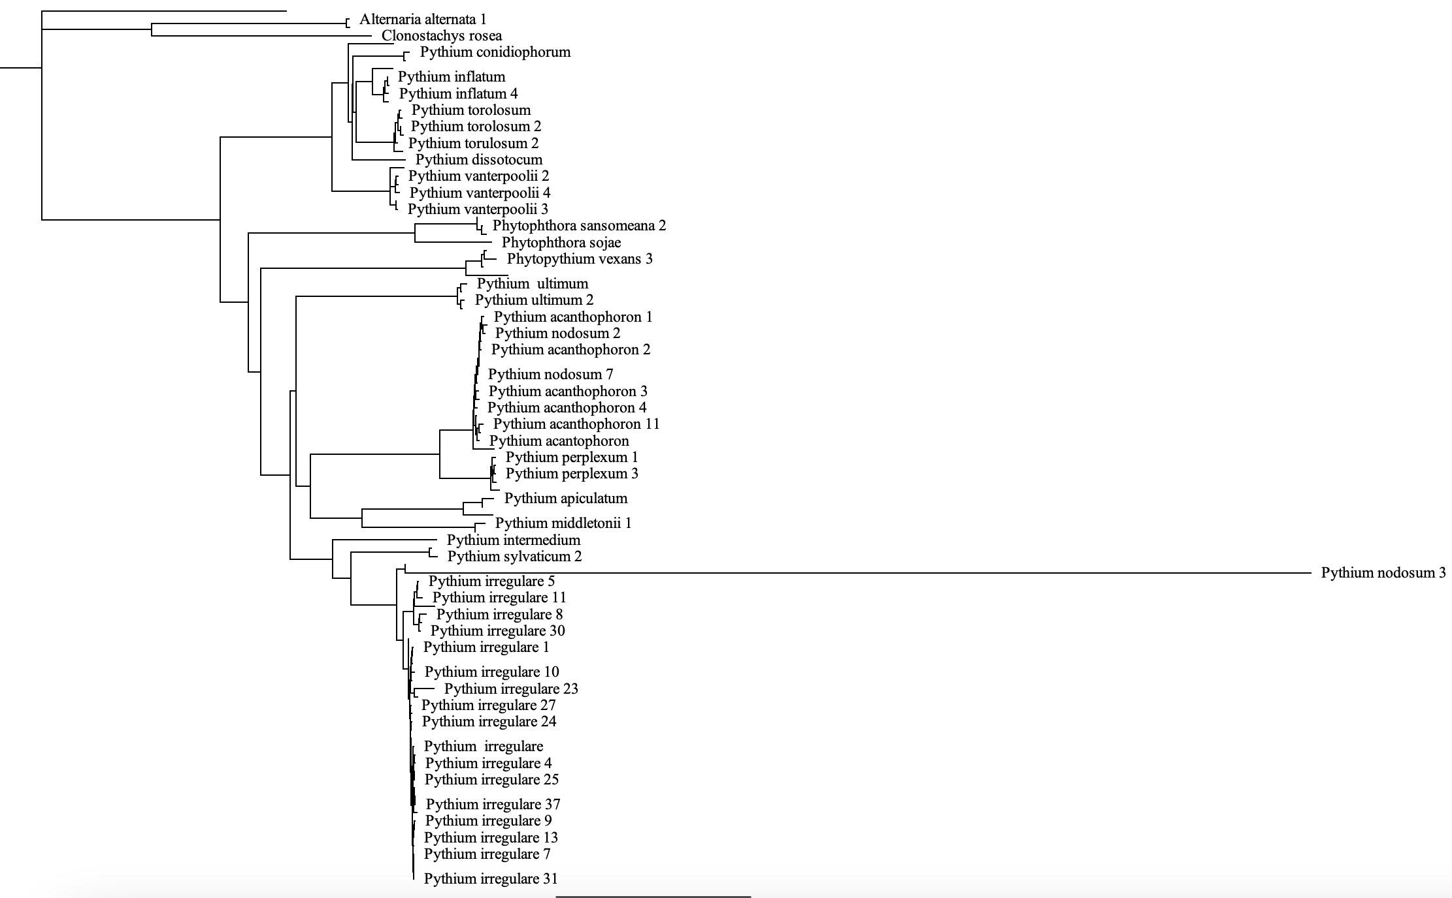
NEIGHBOR-JOINING TREE
Nodes: 211
Tips: 106
Notes:
The neighbor-joining method using Tamura and Nei’s distance calculation of the aligned sequence yielded a tree with xxx nodes and xxx tips (Figure 2). Although this method is simple, computationally inexpensive, doesn’t require the download and installation of additional software, and can be performed using the RStudio package ‘ape’, it did not present sufficient information regarding the methods parameters and the outputs for the tree yielded.
Regardless, neighbor-joining (NJ) trees present the advantage of giving a more reliable estimate of the estimate of the evolutionary tree (Edgar, 2004a). NJ is also considered a consistent method that can yield correct trees even when the distance calculated is slightly mistaken (Bruno, 2000). However, NJ often reduces the distance information, leading to data loss, and can only display one possible tree (Amelia Harrision, personal communication).

Slide 12
IQ-TREE

Slide 13
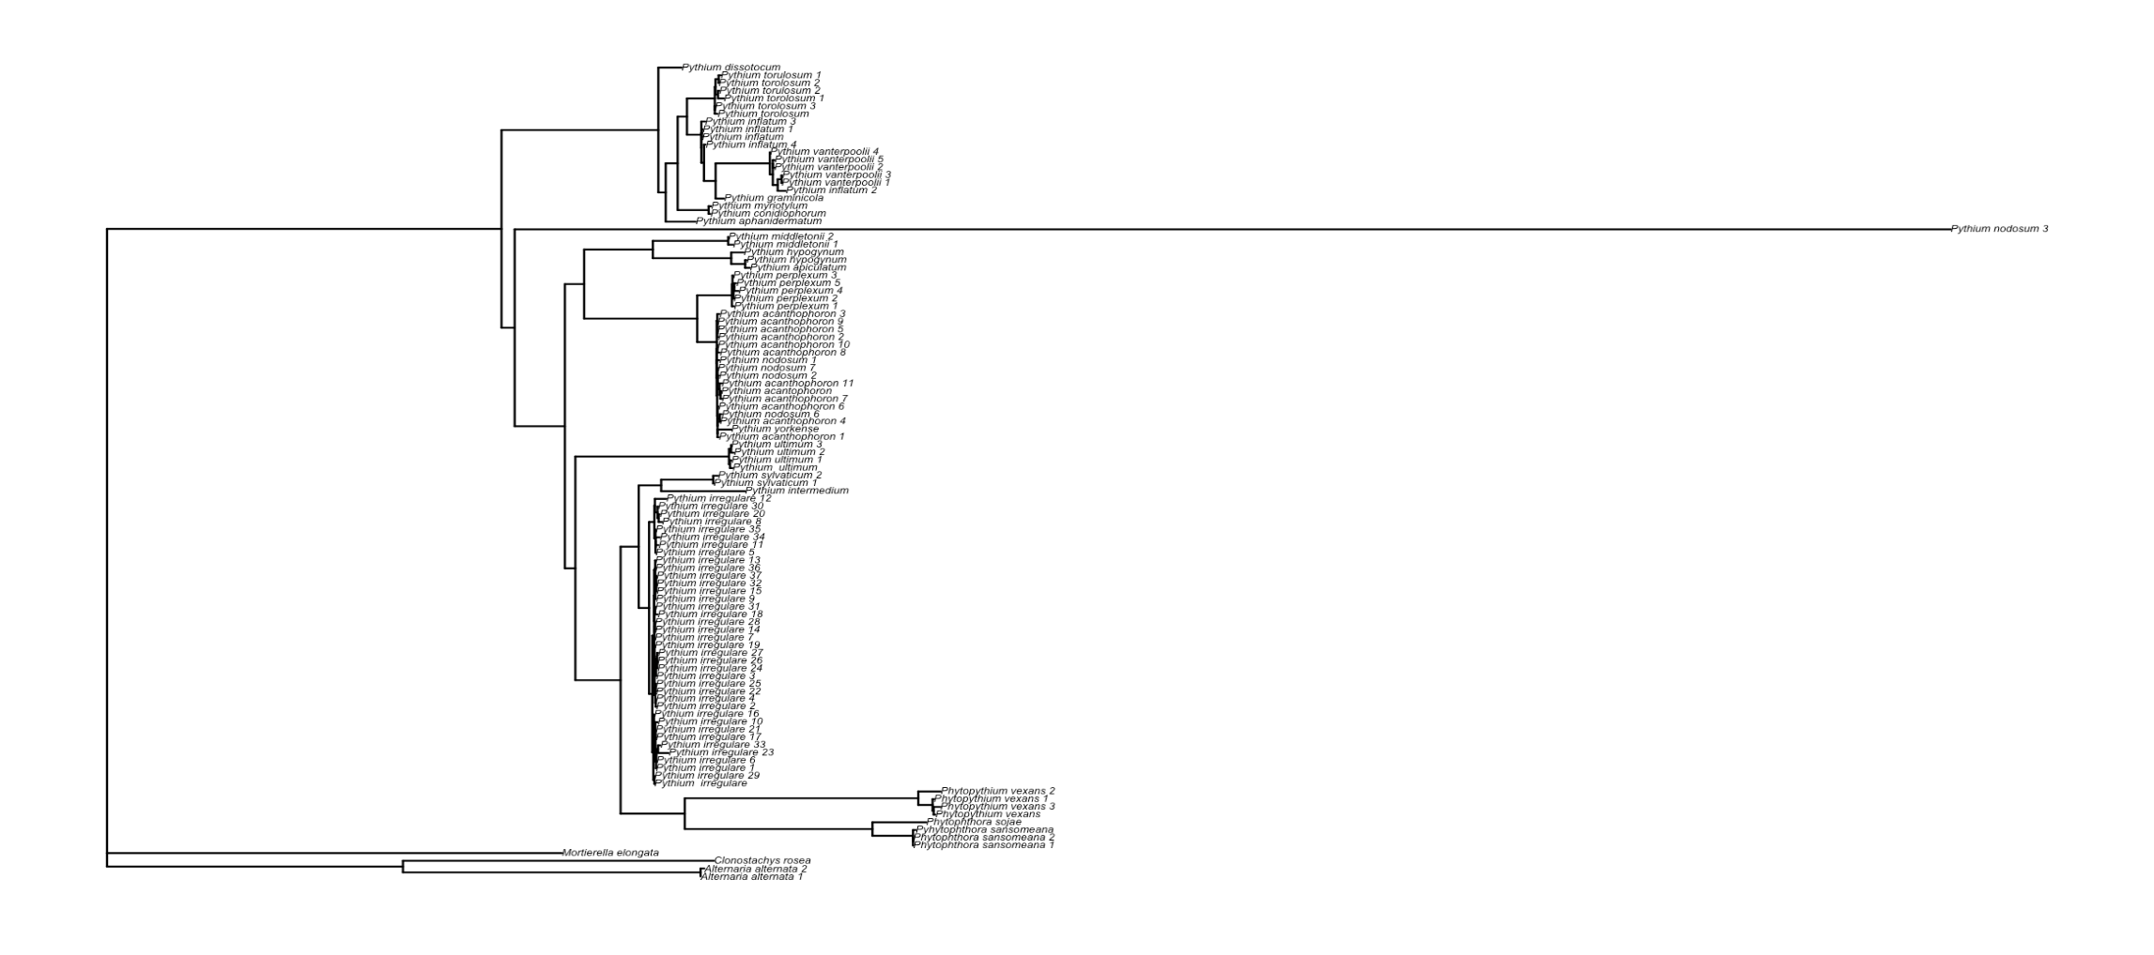
IQ-TREE
Notes:
The program IQ-TREE is a fast and effective tree searcher that combines renowned phylogenetic and combinatorial optimization techniques. The strategies deployed help to escape local optima and lead to trees with a high likelihood. Besides, the phylogenetic likelihood library reduces de time for likelihood computation. Thus, facing the implementation of hill-climbing and stochastic NNI operations, IQ-TREE can create trees with a higher likelihood than RAxML or PhyML (Nguyen et al., 2015).
In disagreement, Zhou et al. (2018) reported that the use of NNI by IQ-TREE can be disadvantageous when compared to the SPR topological mechanism used by RAxML and PhyML since SPR can explore a greater proportion of tree space than NNI. Therefore, whereas the use of IQ-TREE in smaller sequence datasets (fewer taxa), the use of NNI by this program can show limitations as the data set grows larger.

Slide 14
IQ-TREE (output)
Optimal log-likelihood: -14427.901
Base frequencies: A: 0.208 C: 0.193 G: 0.277 T: 0.322
Best score found: -14427.901
Total tree length: 11.156

Slide 15
NJ vs. IQ-TREE: Highlights from the biological perspective
Fungal species were clustered together and more distant from the Oomycete species.
Although in different positions on the different trees, P. sojae and P. sansomeana were clustered in the same clade and closer to other highly pathogenic Pythium species

Slide 16
03
CONCLUSION

Slide 17
THANK YOU
Do you have any question?

